Slide 1
HUNGER FUEL
SRS TEMPLATE

Slide 2
MEMBERS
Member Name | Primary Responsibility | % Contribution | Roll No
Rubab Imran | Frontend Developer & Documentation & UI Designer | 30% | 0673
Laiba Shabir | Team Leader & Backend Developer | 30% | 1046
Areesha Munir | Database Designer | 20% | 0153
Moosa kazim | Tester & QA | 20% | 0893

Slide 3
Introduction:
Problem Statement
People often don’t know which restaurant is good because they cannot see honest reviews.
Sometimes they waste money on food that is not good. Also, users often miss out on restaurant menus, deals, and discounts because this information is scattered across different platforms.
Hunger Fuel is a simple website where users can read and write reviews, view restaurant menus, and see available deals or discounts so they can choose a better place to eat.

Slide 4
Background
Today, many people depend on online reviews before visiting any restaurant. Good reviews help people make better decisions. At the same time, knowing the menu prices and current deals helps users decide if a restaurant fits their budget.
Hunger Fuel works as a basic review and information system where users:
share their eating experience
rate restaurants
view menus
check available deals or discounts
The system is designed to be simple and suitable for university-level learning.

Slide 5
Objectives / Aims / Targets
To help people pick a good restaurant.
To provide clear and honest reviews in one place.
To allow users to view restaurant menus before visiting.
To inform users about available deals and discounts.
To make a simple website that anyone can use easily.
To allow users to rate restaurants based on their experience.
To give admins control to manage restaurant data, menus, and offers.

Slide 6
. Challenges
Making sure reviews are honest.
Keeping the website simple and easy to use.
Managing menus, deals, and discounts for different restaurants.
Handling many reviews and ratings.
Applying basic security for user accounts and admin access.

Slide 7
Product Features
User sign up and login
Restaurant search
View restaurant details
View menus
View deals and discounts
Read reviews and ratings
Write reviews and give ratings
Admin management of restaurants, menus, and offers

Slide 8
Assumptions and Dependencies
Users have internet access
Users provide honest reviews
Restaurants update menu and deal information
Database and hosting remain active
Future features may depend on maps or location services

Slide 9
PROJECT MANAGEMENT

Slide 10
Milestone Table
M1 | Project Initiation | 3 | Day 3
M2 | Requirement Analysis | 5 | Day 8
M3 | System Design | 6 | Day 14
M4 | Development | 12 | Day 26
M5 | Testing | 5 | Day 31
M6 | Deployment | 3 | Day 34
M7 | Documentation & Review | 3 | Day 37
Total Project Duration: 37 Days

Slide 11
Activity List
Activity | Description | Duration | Predecessor
A | Project Initiation | 3 | —
B | Requirement Analysis | 5 | A
C | System Design | 6 | B
D | Core Development (Reviews, Ratings) | 8 | C
E | Menu & Deals Development | 4 | C
F | Integration | 3 | D, E
G | Testing | 5 | F
H | Deployment | 3 | G
I | Documentation & Review | 3 | H
Activity Graph
A → B → C → D → F → G → H → I
↘ E ↗

Slide 12
Critical Path Method (CPM)
Forward Pass
Act | Dur | ES | EF
A | 3 | 0 | 3
B | 5 | 3 | 8
C | 6 | 8 | 14
D | 8 | 14 | 22
E | 4 | 14 | 18
F | 3 | 22 | 25
G | 5 | 25 | 30
H | 3 | 30 | 33
I | 3 | 33 | 36

Slide 13
Critical Path Method (CPM)
Backward Pass
Act | Dur | LS | LF
I | 3 | 33 | 36
H | 3 | 30 | 33
G | 5 | 25 | 30
F | 3 | 22 | 25
D | 8 | 14 | 22
E | 4 | 18 | 22
C | 6 | 8 | 14
B | 5 | 3 | 8
A | 3 | 0 | 3

Slide 14
Activity | Slack (LS − ES)
A | 0
B | 0
C | 0
D | 0
E | 4
F | 0
G | 0
H | 0
I | 0
Critical Path
A → B → C → D → F → G → H → I
Project Duration = 36–37 Days

Slide 15
Activity | 1–5 | 6–10 | 11–15 | 16–20 | 21–25 | 26–30 | 31–35
Initiation | ███
Requirements |  | █████
Design |  |  | ██████
Core Development |  |  |  | ████████
Menu & Deals |  |  |  | ████
Integration |  |  |  |  | ███
Testing |  |  |  |  |  | █████
Deployment |  |  |  |  |  |  | ███
Documentation
Gantt Chart

Slide 16
Functional Requirements
~~~~~~~~~~ Phase II ~~~~~~~~~~

Slide 17
User Login
Identifier |  | UC-1
Purpose |  | To let the user log into the system using email and password.
Priority |  | High
Pre-conditions |  | User already has an account
Post-conditions |  | User is logged in and can access all features.
Typical Course of Action
S# | Actor Action |  | System Response
1
User enters email and password
System checks information
2 | User clicks login |  | System logs the user in
3 | - |  | System takes user to home page
…
Alternate Course of Action
S# | Actor Action |  | System Response
1 | if user enters wrong details |  | System shows error message.
2
3
…

Slide 18
Add Review and Rating:
Identifier |  | UC-2
Purpose |  | To allow a user to write a review and give a rating to a restaurant.
Priority |  | High
Pre-conditions |  | User must be logged in.
Post-conditions |  | Review is saved and shown on the restaurant page.
Typical Course of Action
S# | Actor Action |  | System Response
1
User selects a restaurant
system shows details
2 | User clicks “Add Review” |  | System opens review box
3 | User writes review and rating |  | System saves review
… | - |  | System updates average rating
Alternate Course of Action
S# | Actor Action |  | System Response
1 | If input is empty |  | System shows “Please enter review”.
2
3
…

Slide 19
Search Restaurant:
Identifier |  | UC-3
Purpose |  | To let users quickly search for a restaurant.
Priority |  | Medium
Pre-conditions |  | User is on home page.
Post-conditions |  | Search results are shown.
Typical Course of Action
S# | Actor Action |  | System Response
1
User types restaurant name
System starts searching
2
User clicks search button
 | System shows matching restaurants
Alternate Course of Action
S# | Actor Action |  | System Response
1 | If no restaurant found |  | System shows “No results found”.
2
3
…

Slide 20
Nonfunctional Requirements*
Performance Requirements
Website pages should open within 3–5 seconds.
Search results should appear quickly.
System should handle many reviews without slowing down.
Safety Requirements
System should not delete user reviews by mistake.
Admin panel should be protected to avoid wrong changes.
Website should prevent data loss during sudden shutdown.
Security Requirements
Users must log in with correct email and password.
Passwords must be saved in a secure way.
Only admin can manage restaurant data.
User data must not be shared with others

Slide 21
Other Requirements
Usability:
Website must be easy for all users to understand.
Buttons should be clear and simple.
Reliability:
System should work without crashing
Flexibility:
New features can be added later easily.
Maintainability:
Code should be simple so future students can edit it.
Availability:
Website should be available any time if hosted online.

Slide 22
Designing

Slide 23
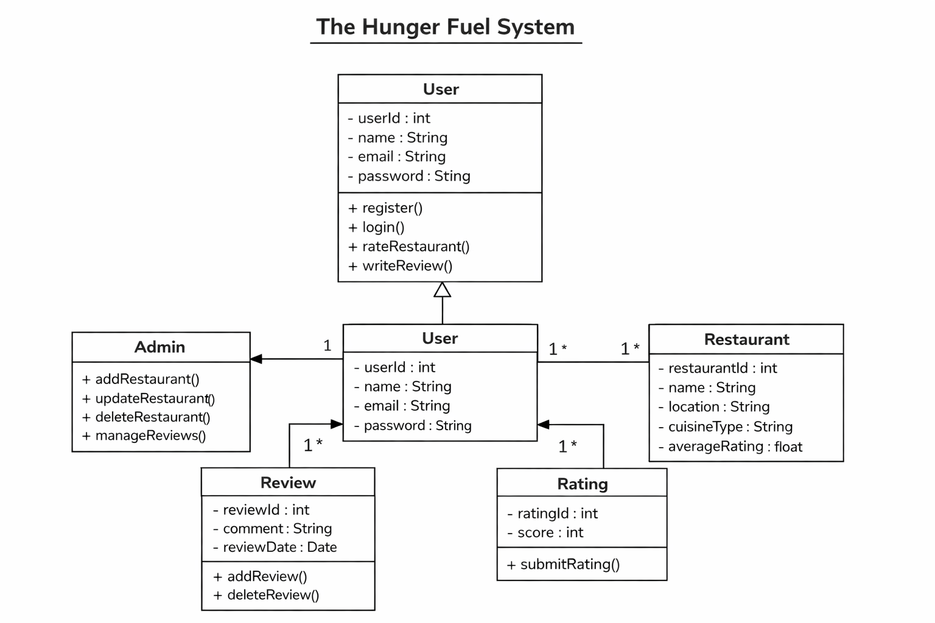
Complete class diagram

Slide 24
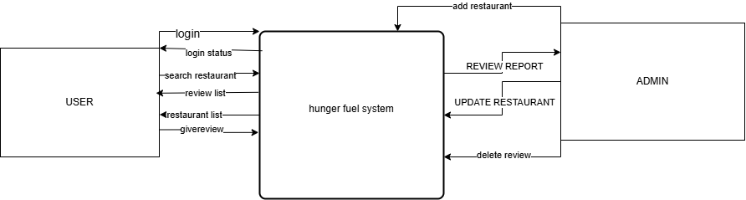
Complete Data Flow Diagram (DFD)
Level 0

Slide 25
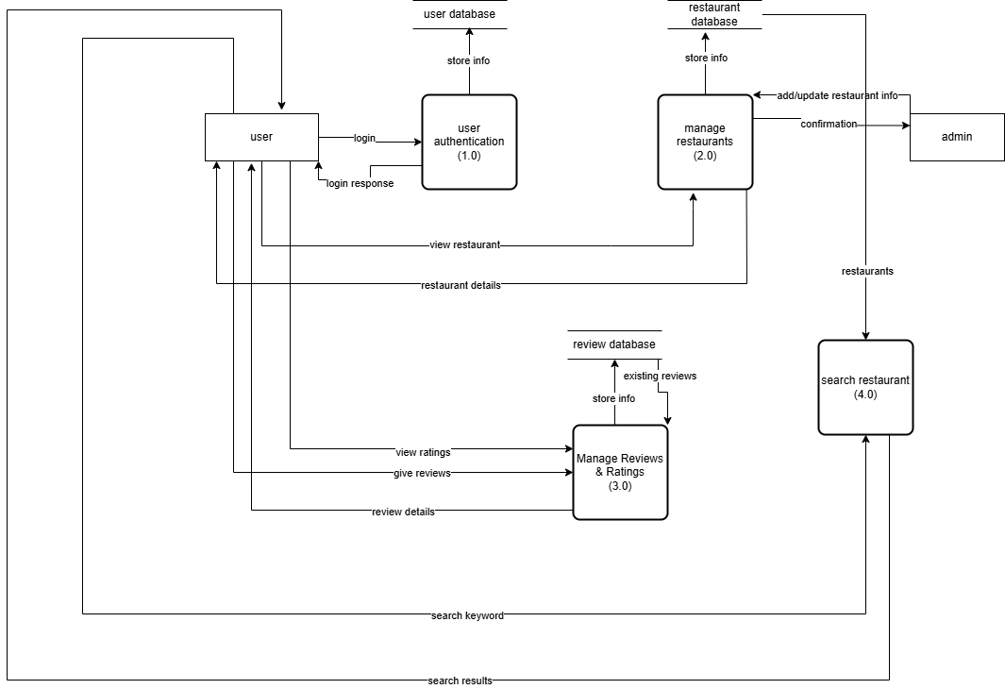
Complete Data Flow Diagram (DFD)
Level 1

Slide 26
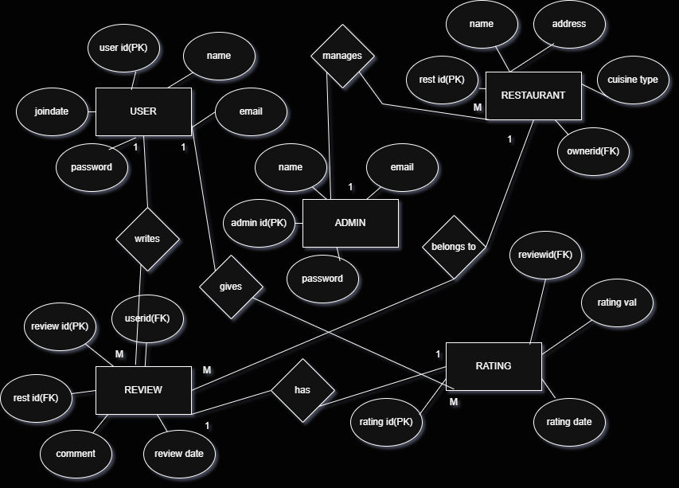
Complete ER Diagram

Slide 27
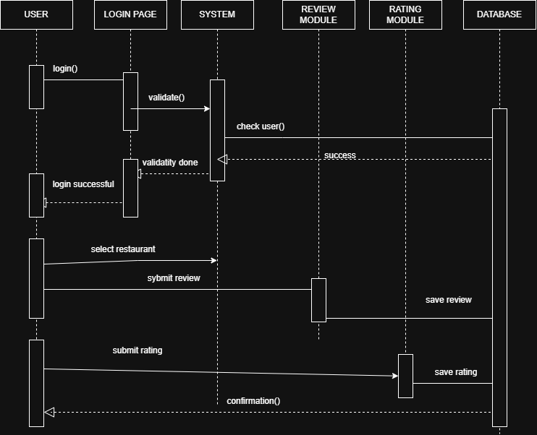
Sequence diagram
Scenario 1
User Submits Review and Rating

Slide 28
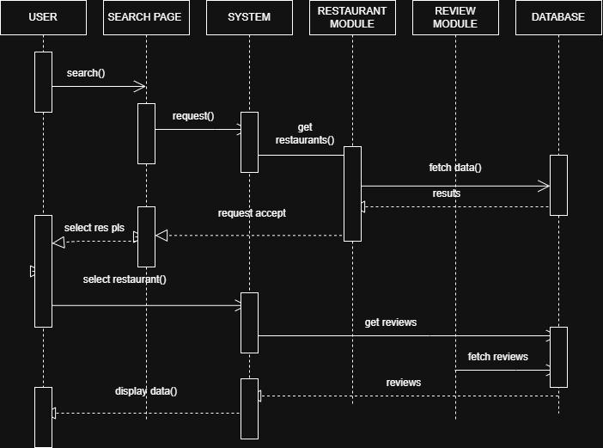
Scenario 2
Admin Updates Restaurant

Slide 29
Estimation

Slide 30
Cost Benefit Estimation(1st year)
Item | Estimated Cost (PKR)
Domain & Hosting | 10,000
Development Effort (student work – nominal) | 30,000
Testing & Deployment | 10,000
Maintenance & Miscellaneous | 10,000
Total Cost | 60,000 PKR

Slide 31
Cost Benefit Estimation(1st year)
Source of Benefit | Estimated Value (PKR)
Advertisements | 40,000
Sponsored Restaurants | 50,000
Increased Platform Usage | 20,000
Total Benefits | 110,000 PKR

Slide 32
Return of Investment (ROI) {1st year}
ROI=>110,000/60,000​=1.83
ROI = 1.83
This means for every 1 PKR invested, the system returns 1.83 PKR.
%gain on ROI {1st year}
%Gain => {(110,000-60,000)/60,000}*100
%Gain => 83.33%
Payback Period in years
Payback Period => 60,000/110,000 ​= 0.54 years
Payback Period = 0.5 years (about 6–7 months)
our project can recover its cost within the first year

Slide 33
FP based Estimation
Component | Count
External Inputs (Login, Signup, Add Review) | 5
External Outputs (View Reviews, Ratings) | 4
External Queries (Search Restaurant) | 3
Internal Logical Files (Users, Restaurants, Reviews) | 3
External Interface Files | 1

Slide 34
Type | Weight | Total FP
Inputs | 5 × 4 | 20
Outputs | 4 × 5 | 20
Queries | 3 × 4 | 12
Internal Files | 3 × 10 | 30
Interface Files | 1 × 7 | 7
Unadjusted FP = 89
Assuming simple system complexity:
FP = 90

Slide 35
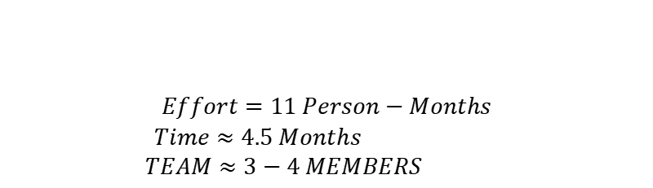
COCOMO Estimation:
LETS ASSUME:
1 FP = 50 LOC (for web systems)
LOC => 90*50 = 4500 LOC
KLOC => 4500/1000 = 4.5
$$Effort=11 Person−Months$$
$Time≈4.5 Months$
$TEAM≈3−4 MEMBERS$

Slide 36
References
Slides
Course material
Software Engineering- A Practitioner's Approach by Roger S. Pressman

